Slide 1
Background and Problem Statement
Diabetes is a public health problem worldwide. Although diabetes is a chronic and incurable disease, measures and treatments can be taken to control it and keep the patient stable.
Diabetes has been the subject of extensive research, ranging from disease prevention to the use of technologies for its diagnosis and control.
Health institutions obtain information required for the diagnosis of diabetes through various tests, and appropriate treatment is provided according to the diagnosis.
These institutions have databases with large volumes of information that can be analyzed and used in different applications such as pattern discovery and outcome prediction, which can help health personnel in making decisions about treatments or determining the appropriate prescriptions for diabetes management.
Objective is to develop a Diabetes Drug Recommendation System that leverages data-driven methodologies to provide personalized drug recommendations for diabetes management.
By analyzing patient data, this system seeks to enhance the quality of care by recommending the most suitable medications, considering patient-specific factors and preferences.

Slide 2
Proposed System

Slide 3
Data Collection
Data Sources: Publicly available health datasets were identified and used.
Data Types: Data collected included structured data such as demographics, lab results, prescriptions, diagnosis etc.
Data Size and Scale: Dataset contained around 1,01,767 records of patients collected from around 128 hospitals which included columns such as A1C_result, race, gender, previously prescribed drugs etc.
Data Preprocessing: Handling missing values, removing duplicates, KNN imputing, Scaling techniques, TFIDF vectorization for NLP, SMOTE analysis.

Slide 4
Final Feature Selected
Race : African-American, Asian, Caucasian, Hispanic, Other
Gender : Male, Female
Age : Numeric value
Weight : Numeric value
A1_C result : Also known as the hemoglobin A1C or HbA1c test—is a simple blood test that measures your average blood sugar levels. Indicates the range of the result or if the test was not taken. Values: “>8” if the result was greater than 8%, “>7” if the result was greater than 7% but less than 8%, “normal” if the result was less than 7%, and “none” if not measured.
Max Glucose Serum Level : Indicates the range of the result or if the test was not taken. Values: “>200,” “>300,” “normal,” and “none” if not measured
Symptoms : Symptoms seen/experienced by the patient
List of recommended drugs: 'Metformin’, 'Glipizide’, 'Glyburide’, 'Insulin’ (Dependant feature or y)
List of Diabetic Type: Type1 ,Type2 (Dependant feature or y)

Slide 5
Technologies Used
Programming Languages: Python.
Machine Learning Libraries: Scikit-learn, scipy, SMOTE, KNN imputer, XGB Classifier, Random Forest Classifier.
Data Processing Tools: Pandas, NumPy.
Data Visualization Tools: Matplotlib, Seaborn.
Web Development Frameworks: Flask
Cloud Services: Pythonanywhere for deployment.

Slide 6
Challenges Involved
Right Data selection was very critical for drug recommendation which suited the problem statement and provided meaningful insights
Feature Selection : The dataset contained more than 40+ columns and selecting a best set of columns for the machine learning model to train on.
Handling missing values
Selection the best machine leaning model.
Selection of drugs for the recommendation system to be recommended from the dataset.

Slide 7
Future scalability
The future scalability of a drug recommendation system depends on several factors, including technological advancements, data availability, regulatory changes, and healthcare system developments.
Ongoing advances in machine learning and artificial intelligence will enable more sophisticated algorithms. This includes deep learning techniques and natural language processing (NLP), which can improve the system's ability to understand and interpret medical literature, patient records, and other data sources.
Regulatory agencies are likely to evolve their stance on digital health tools, including drug recommendation systems. This will influence how such systems can be deployed and the level of scrutiny they will face.
Advances in pharmacogenomics and patient profiling will allow systems to tailor drug recommendations to an individual's genetic makeup and health history.
The growth of telemedicine and remote monitoring technologies will create opportunities for drug recommendation systems to play a more active role in patient care. Remote consultations can be augmented with digital tools for prescribing and monitoring drug usage.
The scalability of drug recommendation systems will also be influenced by advances in AI-driven drug discovery. As new drugs are developed, these systems can provide more up-to-date information and recommendations.

Slide 8
End Users and Domains benefitted
Patients:
Personalized Treatment: Patients can receive more personalized treatment recommendations based on their medical history, genetics, and other factors, potentially leading to more effective and safer treatments.
Improved Adherence: Patients can receive guidance on how to properly take their medications and understand potential side effects, which can improve medication adherence and health outcomes.
Healthcare Providers:
Clinical Decision Support: Physicians and other healthcare professionals can access drug recommendations that consider a patient's specific condition, medical history, and drug interactions, enhancing clinical decision-making.
Reduced Medication Errors: These systems can help reduce medication errors, as they provide real-time alerts about potential adverse drug interactions and dosing errors.
Efficiency: Healthcare providers can save time by quickly accessing up-to-date information about drug efficacy, safety, and alternatives.
Pharmacists:
Medication Counseling: Pharmacists can use drug recommendation systems to provide more detailed and accurate medication counseling to patients, addressing concerns and ensuring proper medication use.
Drug Interaction Alerts: These systems can assist pharmacists in identifying potential drug interactions and recommending suitable alternatives.
Researchers and Drug Developers:
Drug Discovery: Researchers can use these systems to explore existing drugs and their potential uses for new indications, accelerating drug discovery and development.
Real-world Evidence: Access to real-world patient data and outcomes can help researchers identify trends and insights related to drug effectiveness and safety.

Slide 9
Health Insurers and Payers:
Cost Savings: Health insurers and payers can benefit from more cost-effective treatment plans and reduced hospitalizations resulting from improved patient adherence and more targeted treatments.
Risk Management: These systems can help insurers identify and manage risks associated with specific medications and medical conditions.
Regulatory Authorities:
Safety Monitoring: Regulatory agencies can use drug recommendation systems to monitor the safety of medications in the market by analyzing real-world data and adverse event reports.
Pharmaceutical Companies:
Market Insights: Drug recommendation systems can provide pharmaceutical companies with insights into market demand, medication usage patterns, and potential areas for drug development.
Pharmacovigilance: These systems can assist in post-market surveillance to monitor and report adverse drug events.
Public Health Agencies:
Epidemiological Research: Public health agencies can leverage drug recommendation systems for epidemiological research, tracking disease patterns and treatment outcomes.
Patients' Advocacy Groups:
Empowering Patients: Advocacy groups can help patients access and understand the recommendations provided by these systems, giving patients a more active role in their healthcare decisions.
Telemedicine and Digital Health Platforms:
Remote Consultations: Telemedicine platforms can integrate drug recommendation systems to provide real-time, data-driven treatment recommendations during remote consultations.
Health Monitoring: Digital health platforms can use these systems to monitor patient adherence and adjust treatment plans as needed.

Slide 10
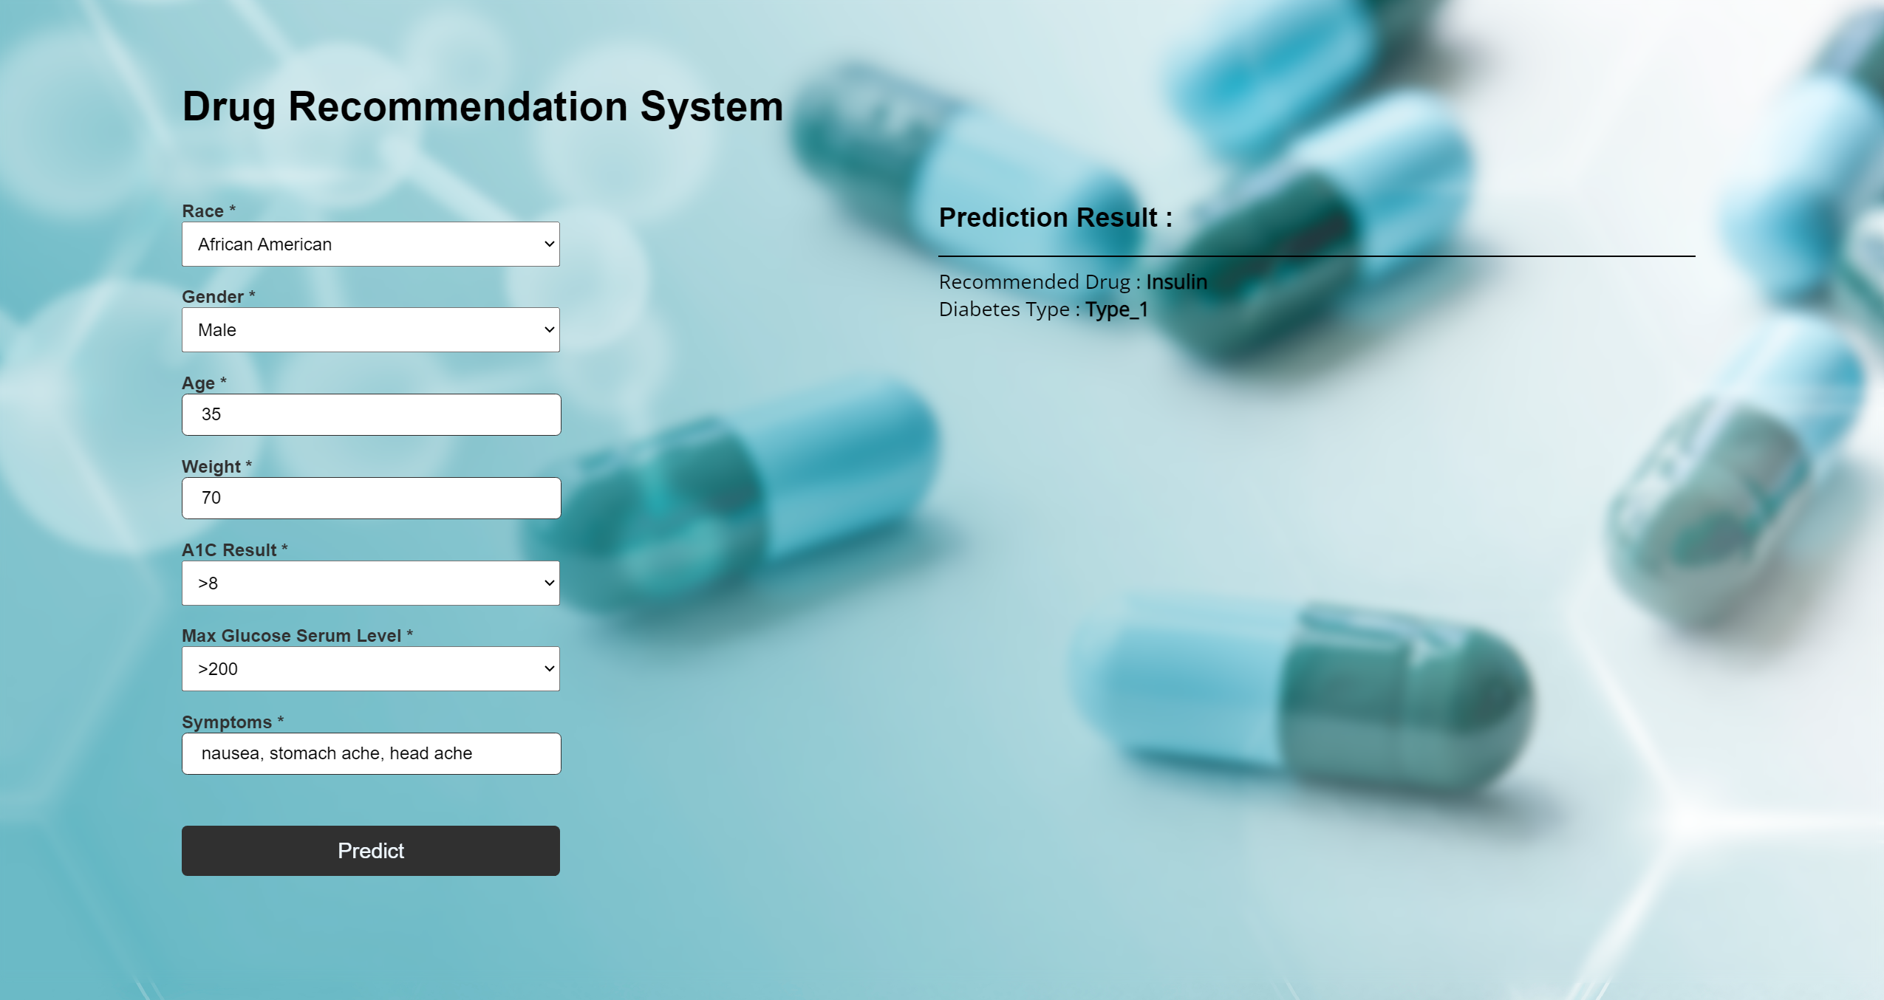
Screen Shots

Slide 11
Team Members
Suryakant Dubey- Leader
Shivali Krishna- Mentor
Dhanush Nayak- Mentor
Pranita Zaware- Mentor
Ajay Kalaskar- Data Scientist.
Aniket Tathe- Data Scientist.

Slide 12
Thankyou

